Slide 1


Leave
Management System
Presented By :
Mukinda Patare
Vishal Gangurde
Pratiksha Nigudkar
Ritik Saini
Prashant Singh

Slide 2
TABLE OF CONTENTS
01·
02·
03·
04·
05·
06·
07·
Introduction
Objectives
Project Modules
Diagrams
Project Screenshots
Future Confines
Conclusion

Slide 3
01·
INTRODUCTION

Slide 4
Leave Management System is our web application software which can be used to apply and manage employee leave in the organisation.
In our web application admin and manager can also manage leaves as per their privileges.
Employees can seamlessly apply for leave also they can check their leave balance as well as their personal profiles.
Leave Management System can be extended in future for other useful features.

Slide 5
Technology Stack
Development Type | Technology Name
Front End | HTML,CSS,Bootstrap
Back End | Java
Validation | JavaScript
Database | Oracle Database

Slide 6
02·
Objectives

Slide 7
In this growing world technologies automated and computerized.
This days organizations having thousands of employees.
To manage leave applications of all this employees there is need of system which can handle this task.
This project simplifies leave management and employee management task.

Slide 8
03·
Project Modules
Admin Module
Manager Module
Employee Module

Slide 9
Admin Module
Initiatory task is handled by admin module which is to add new employee and create unique employee user account and auto generate unique username and password.
This module handles all administrative functions of the system and is used by employees of Leave management system.
Admin can also view his own profile details.

Slide 10
Employee Module
In Employee module employee can use various functions.
Firstly if employee want leave on any working day excluding weekends and holidays he can apply for leave.
Employee can also check his previous leave applications and their status in leave history page.
In this module employee can view current year holiday list.
Also employee can view his leave balance and applicable leave
type.

Slide 11
Manager Module
In Manager module manager can use various functions.
Whenever employee applies for leave that leave request can be managed by manager.
Manager has rights to take relevant action on leave request such Approve or Reject leave.
He can also view entire year holidays.
Manager can also see on which project he is currently working.

Slide 12
04·
Diagrams

Slide 13
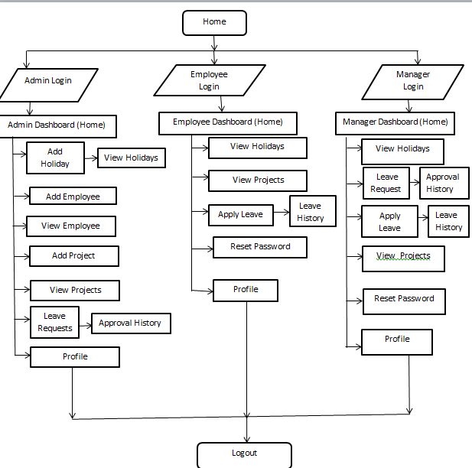

Slide 14
Project
Screenshots
05·

Slide 15
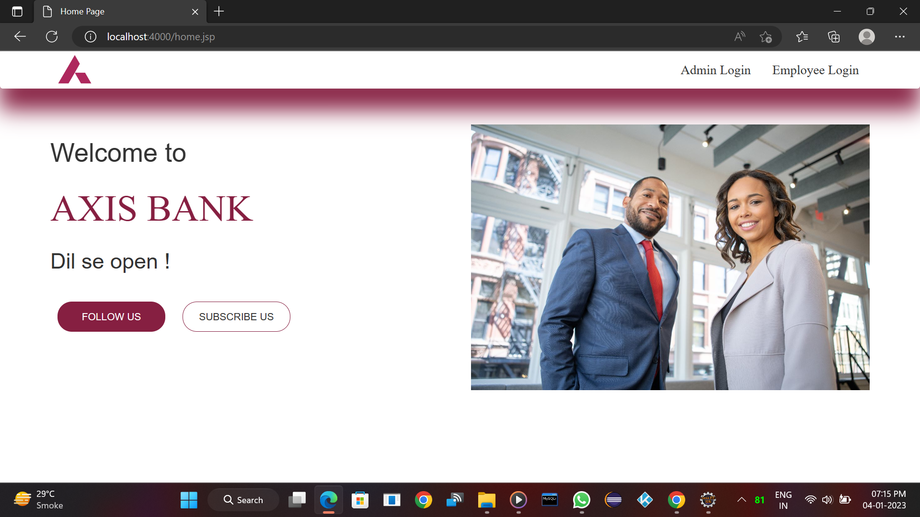

Slide 16
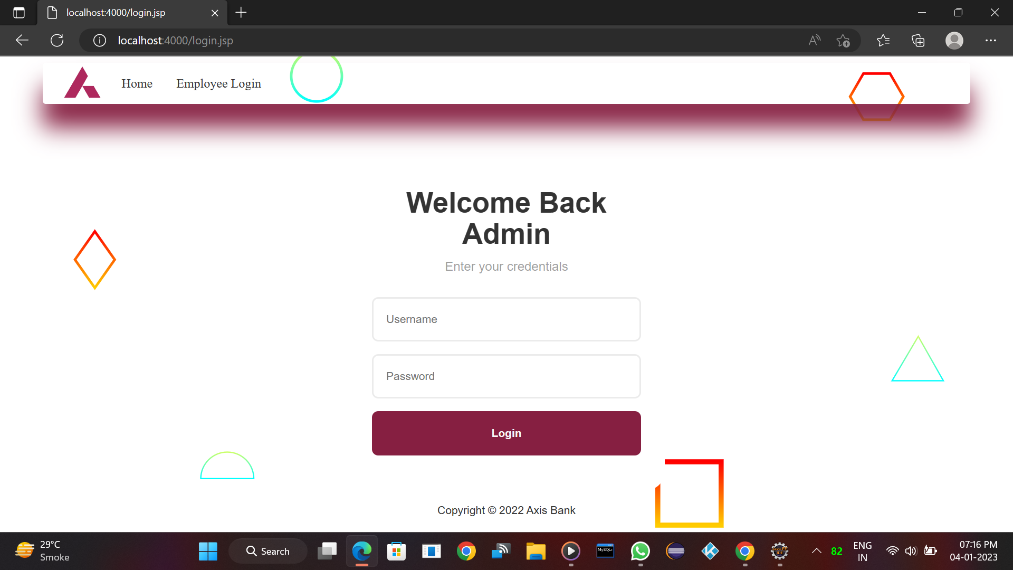

Slide 17
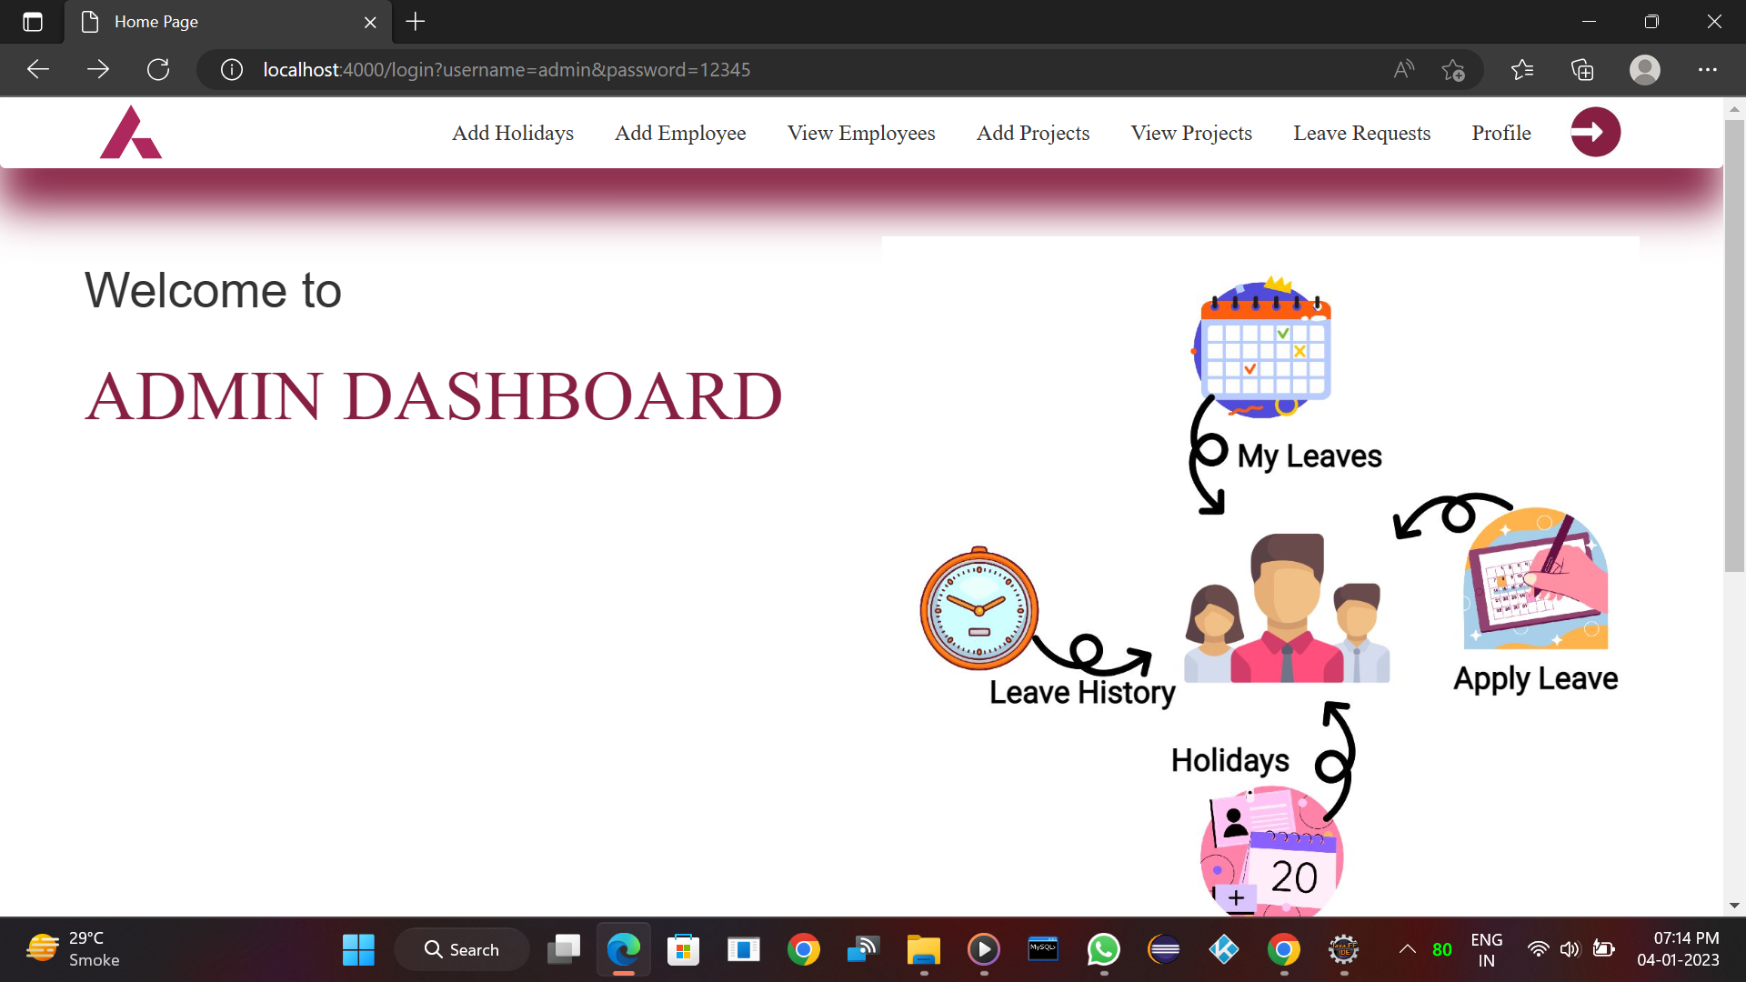

Slide 18
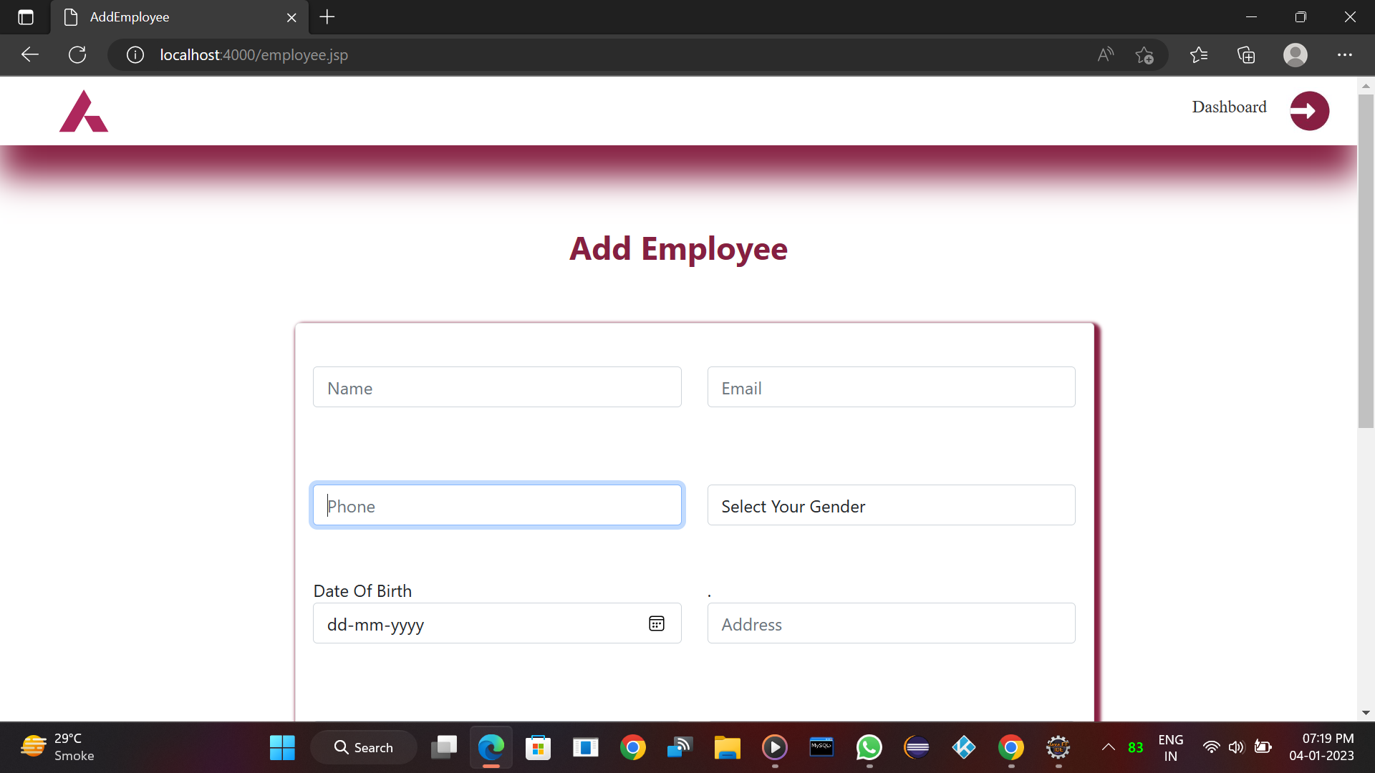

Slide 19
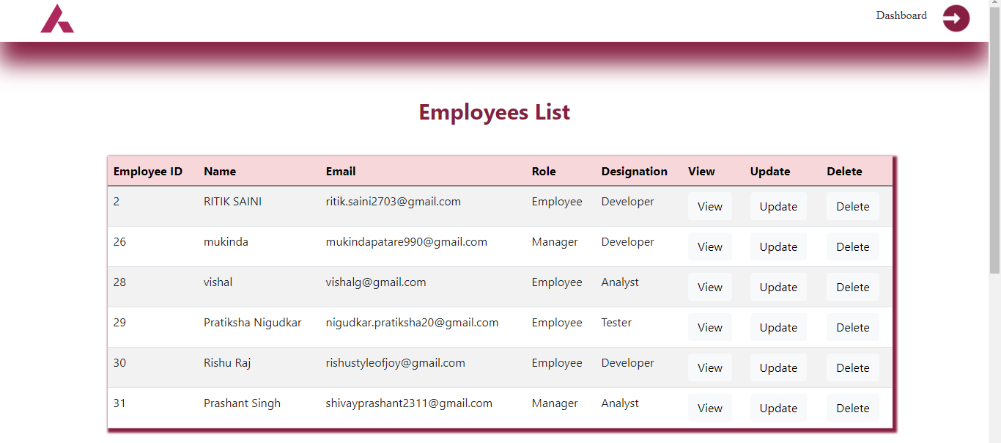

Slide 20
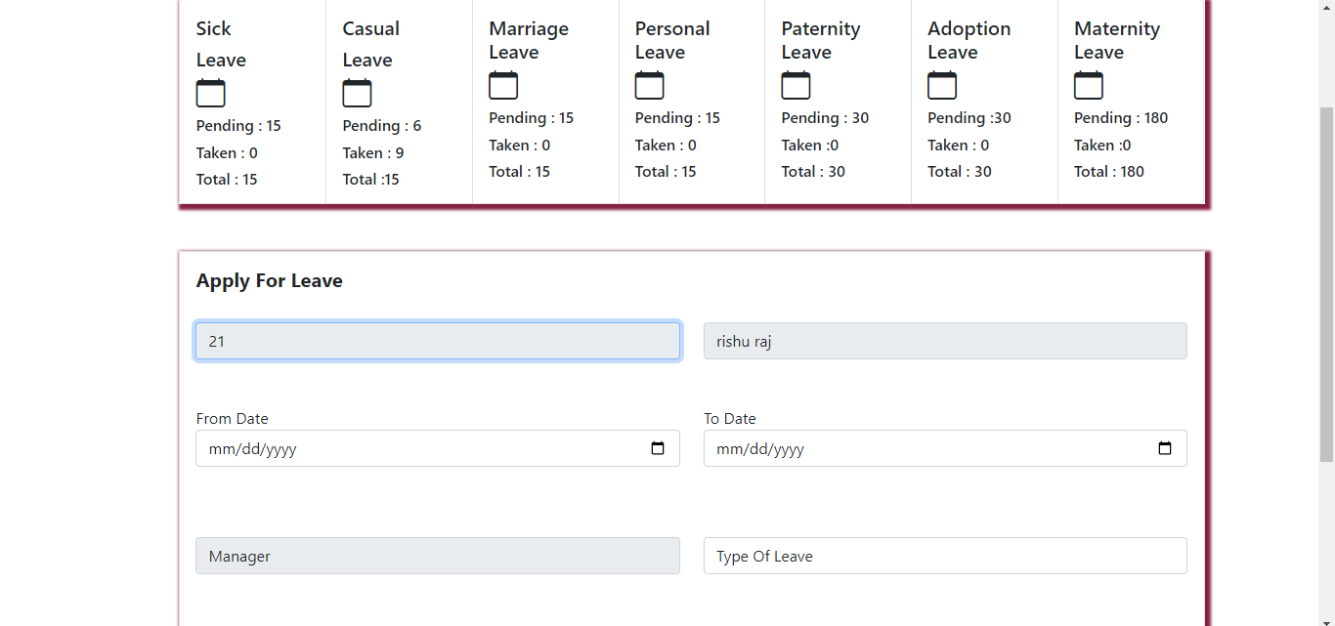

Slide 21
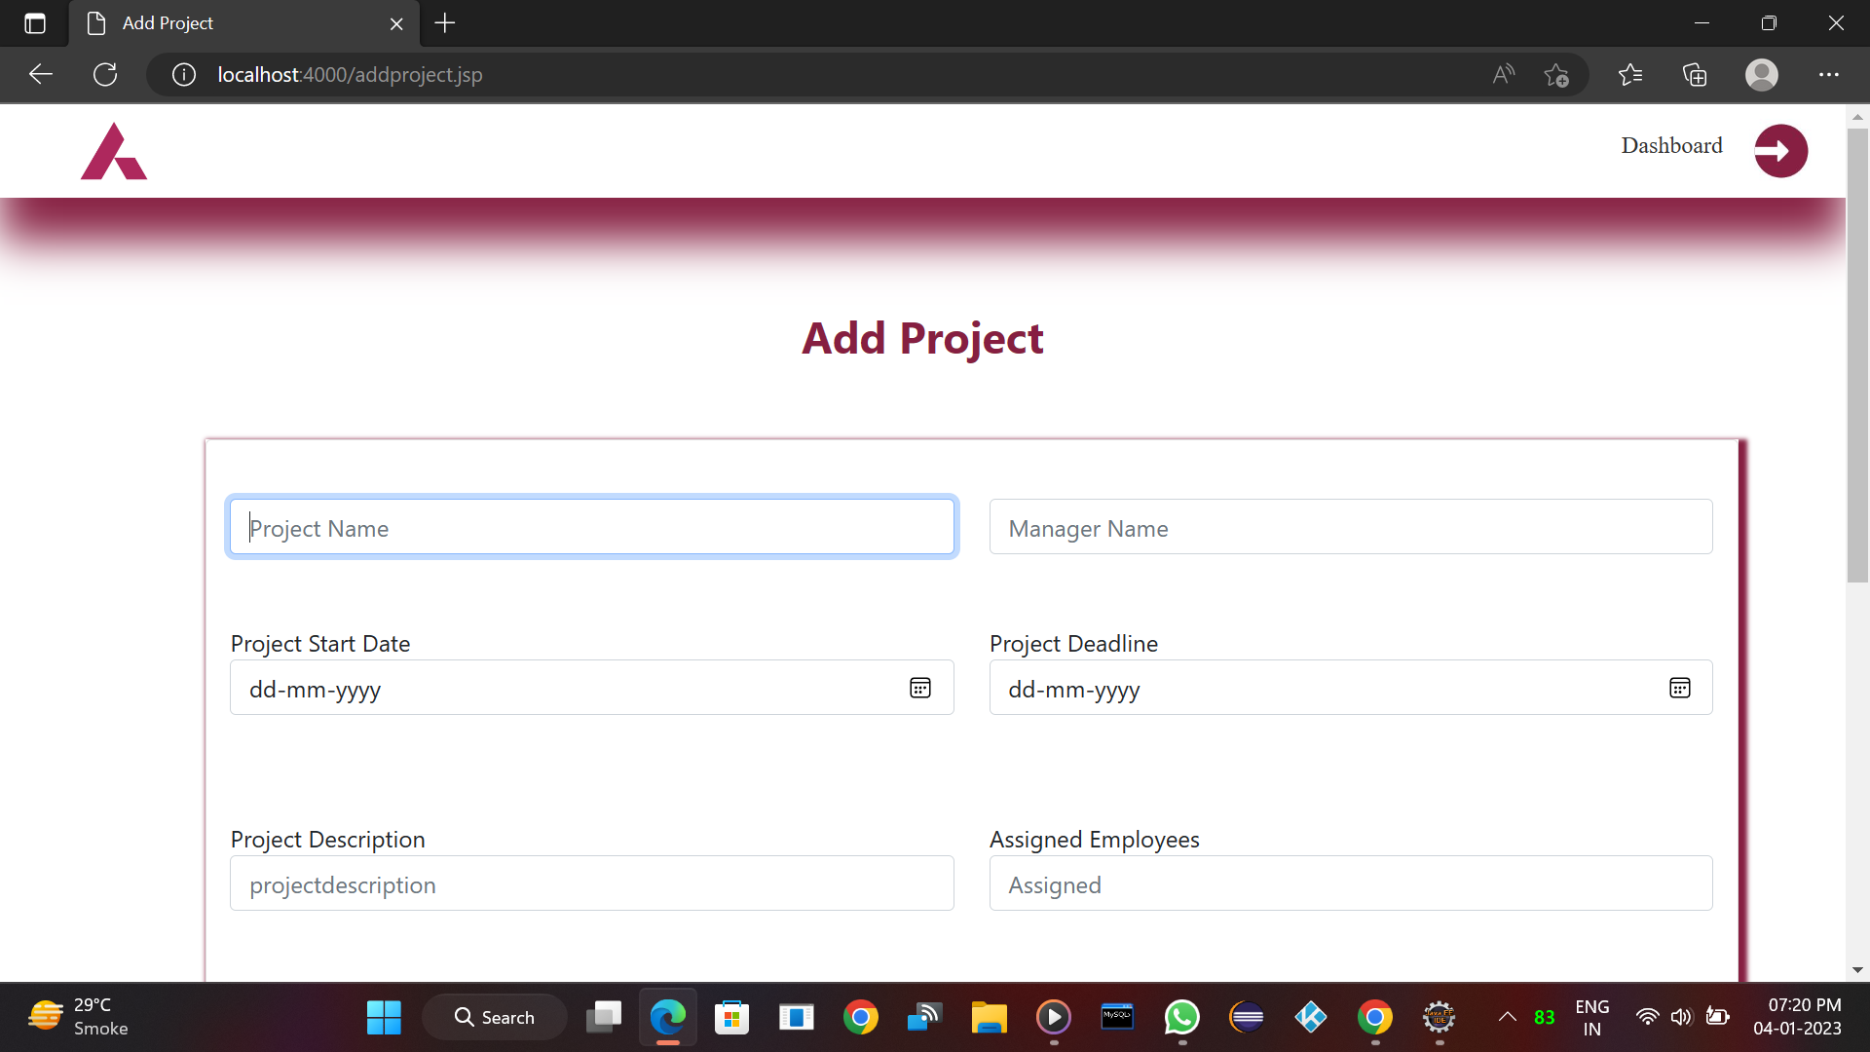

Slide 22
Future Confines
06·

Slide 23
This project can be extended in future with lots of additional useful features.
In future we can give more privileges to managers.
Leaves which are not used by employee can automatically encashed at the end of financial year as per company policy.
Information related to employees performance can be shown using graphs.
We can also provide leave request tracking feature in future.

Slide 24
Conclusion
07·

Slide 25
Leave management system is very important web application.
This software is very useful to manage employee leaves
This project has wide future scope.
Github.Link=https://github.com/ritiksaini2703/Leave-Management-System.git

Slide 26
THANKS!

